Slide 1
An Eco Life
By Chris Southall

Slide 2
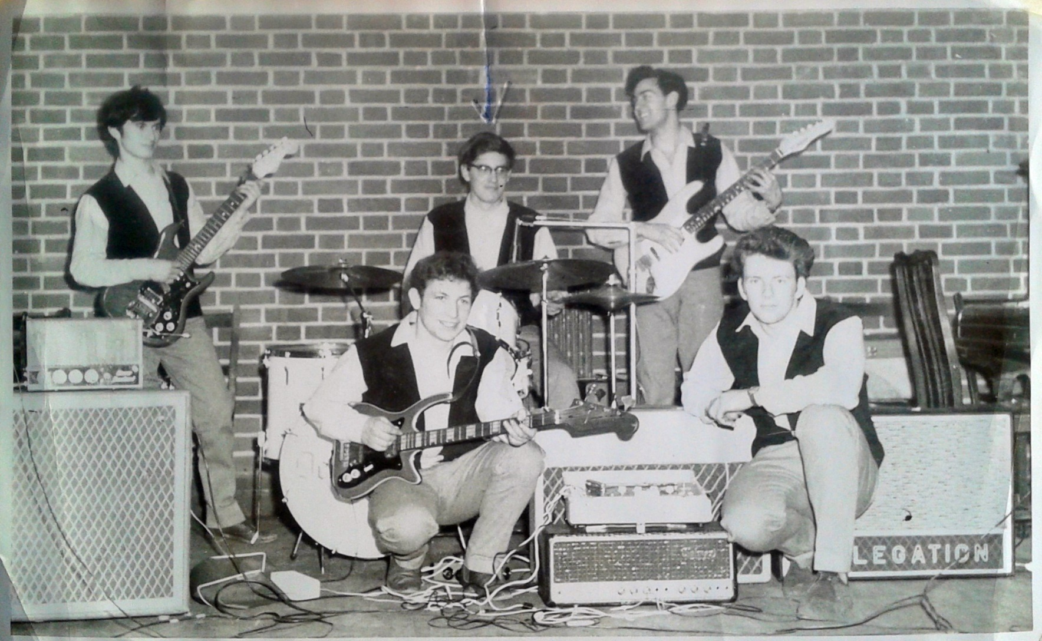
Drumming in the 1960s!

Slide 3
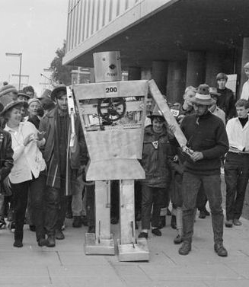
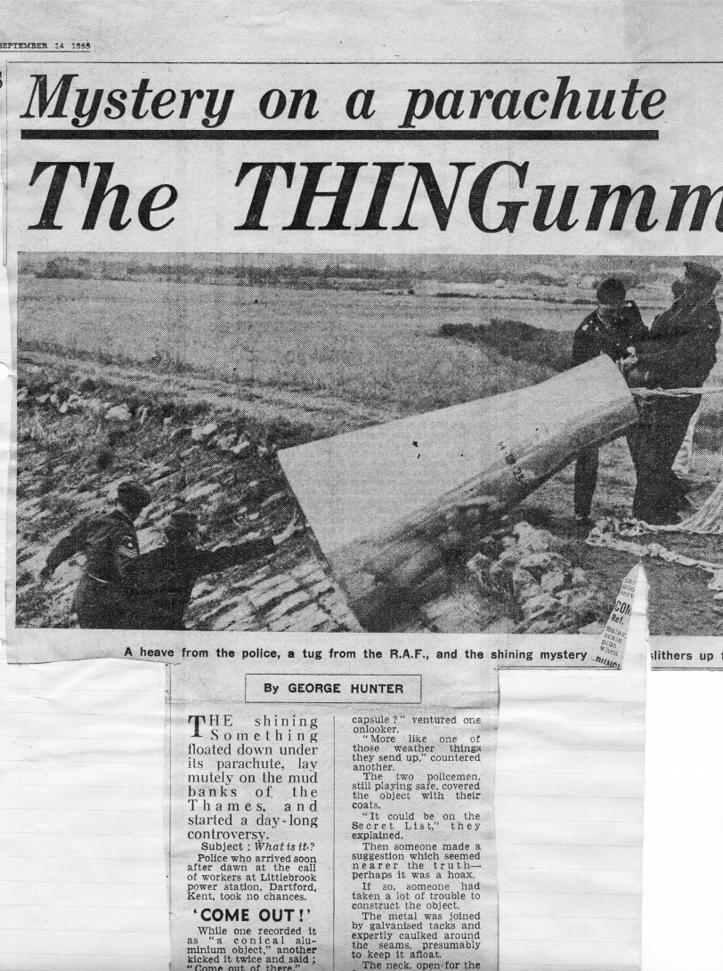
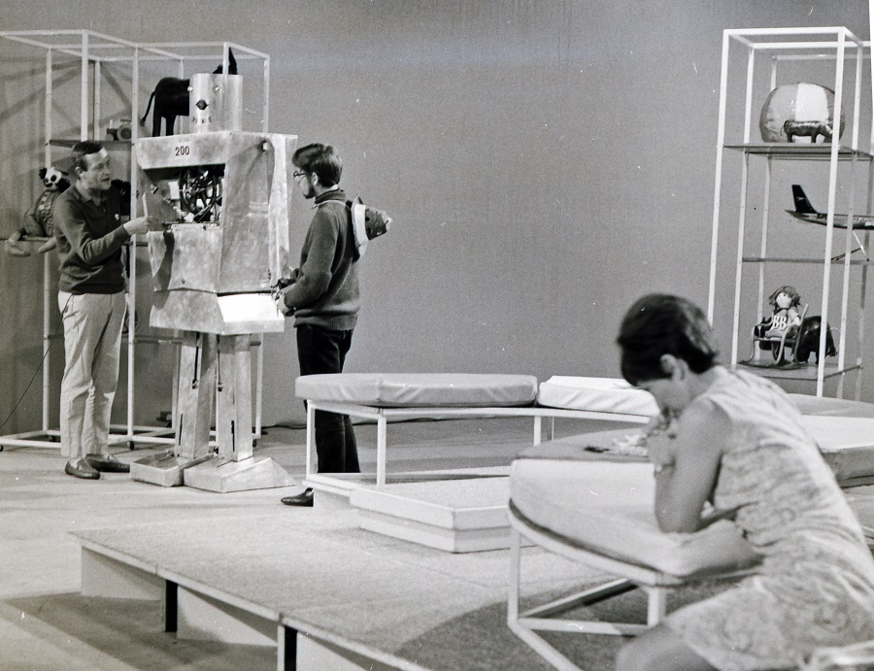
Farnborough Apprentice Rag Stunts
Rodney the robot in London and at Blue Peter studios

Slide 4

BBC One Show

Slide 5
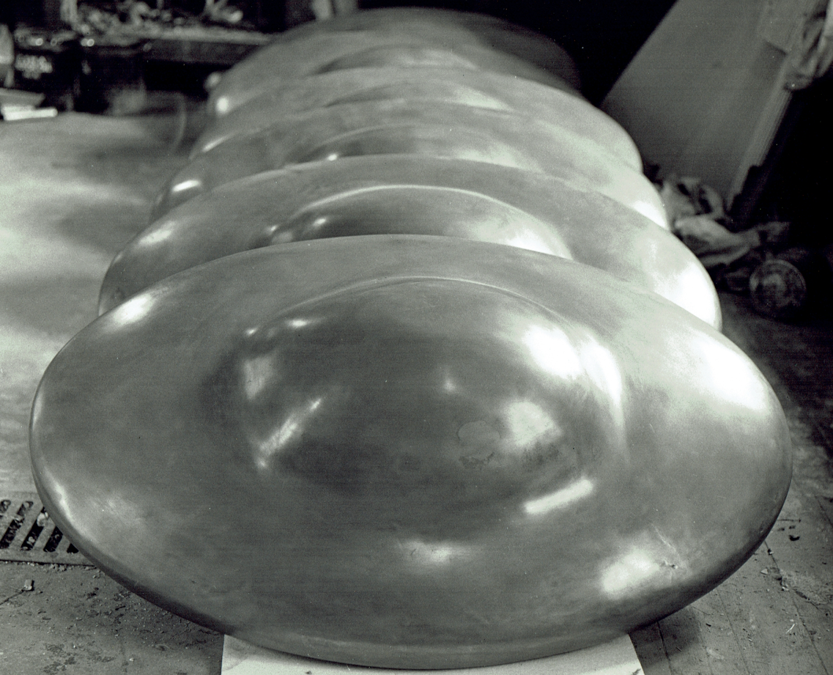
The saucers

Slide 6
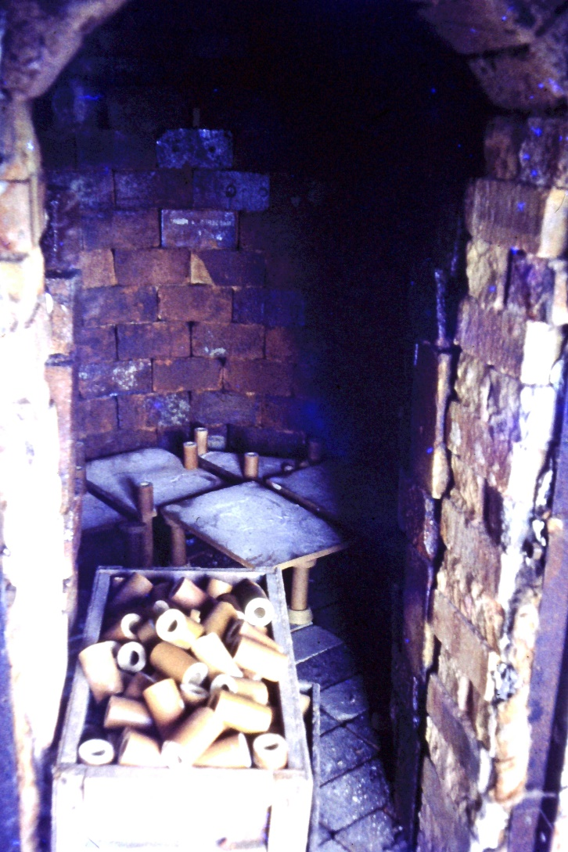
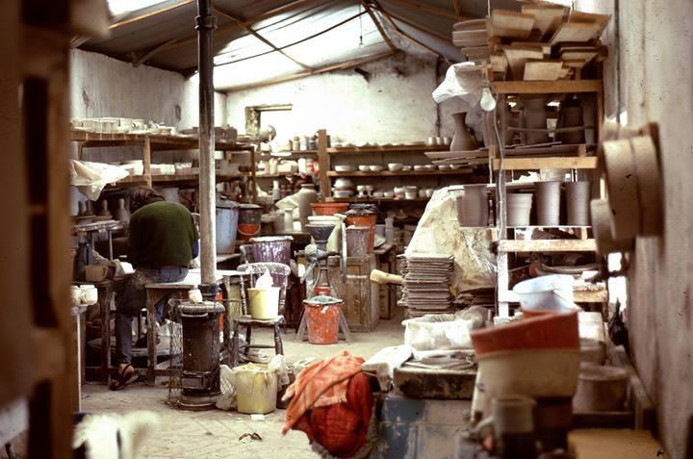
Isle of Man Triskele Pottery
Inside the (old cowbarn) pottery (note the woodstove to help us survive the winter cold
- 6 foot high wood fired kiln

Slide 7
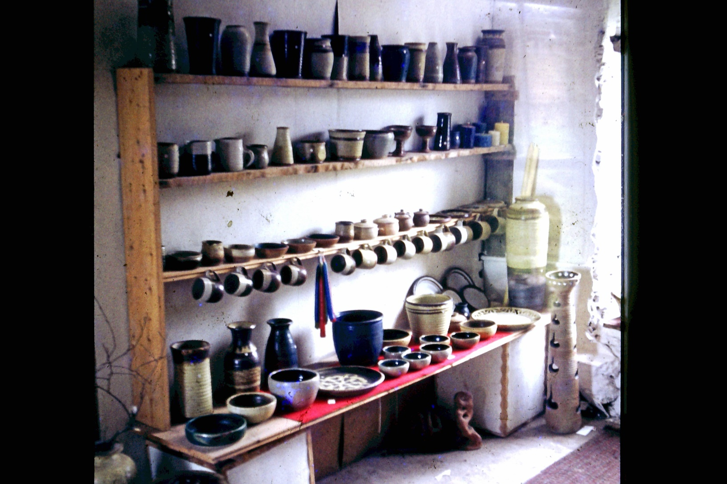
Pottery Shop

Slide 8
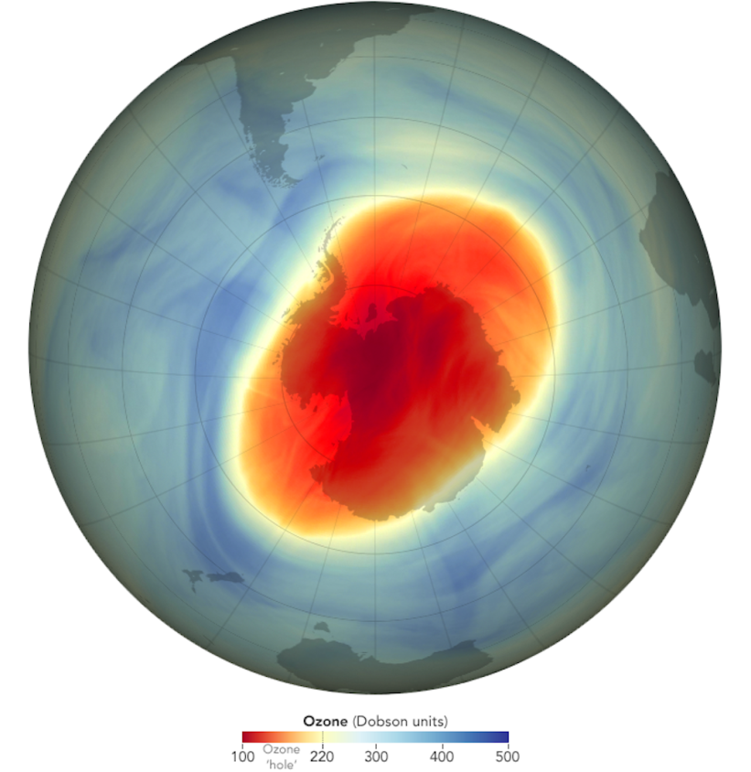
Insect apocalypse, Ozone layer scare 1985 and Silent Spring by Rachel Carson (1962)
Some good news; Ozone Hole Continues Shrinking in 2022, NASA and NOAA Scientists Say
Some bad news; The most diverse group of organisms on the planet are in trouble, with recent research suggesting insect populations are declining at an unprecedented rate.

Slide 9
Inspiration
John Seymour In 1976, wrote The Complete Book of Self-Sufficiency
Bernard Leach 1940: A Potter's Book Taught the integrity of a life of a craftsperson and the authenticity of being true to the nature of materials
Watching ‘The Good Life’ 1975; series on TV in case we got too serious

Slide 10
Some Key books in 1970s
Limits to Growth (highly prescient) 1972 Commissioned by the Club of Rome
Future Shock by Alvin Toffler predicted the kind of things we are seeing in the states around Trump and here with Brexit
Small is Beautiful 1973 by E F Schumacher
A Study of Economics As If People Mattered

Slide 11
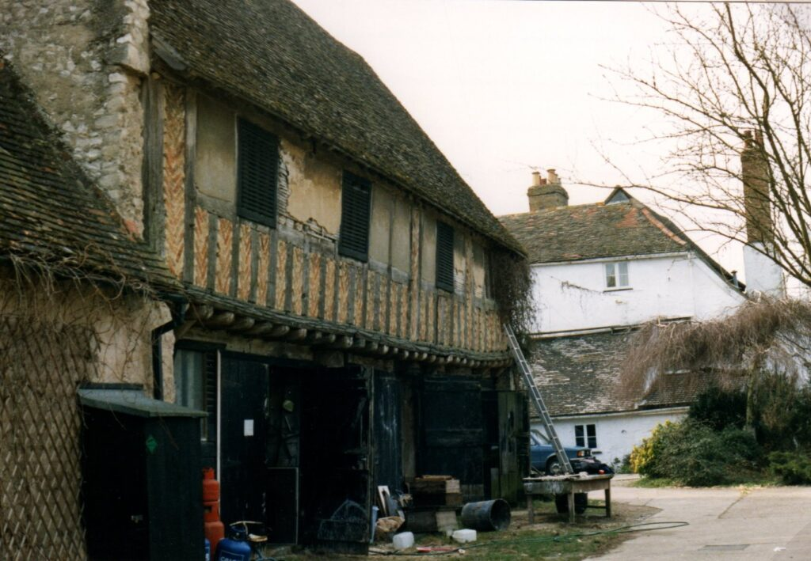
Commune life
After 9 years of off-grid self sufficiency moving to Parsonage Farm commune near Cambridge

Slide 12
Commune life- caring and sharing
Over the 20 years working as
Potter and pottery teacher in health service
9 years Computer builder and recycler
2 years Beekeeper (50 hives)
9 years self development workshops with drumming, drum making, dance, sweat lodge, wilderness living.
Then meeting Rosie and moving to Clacton

Slide 13
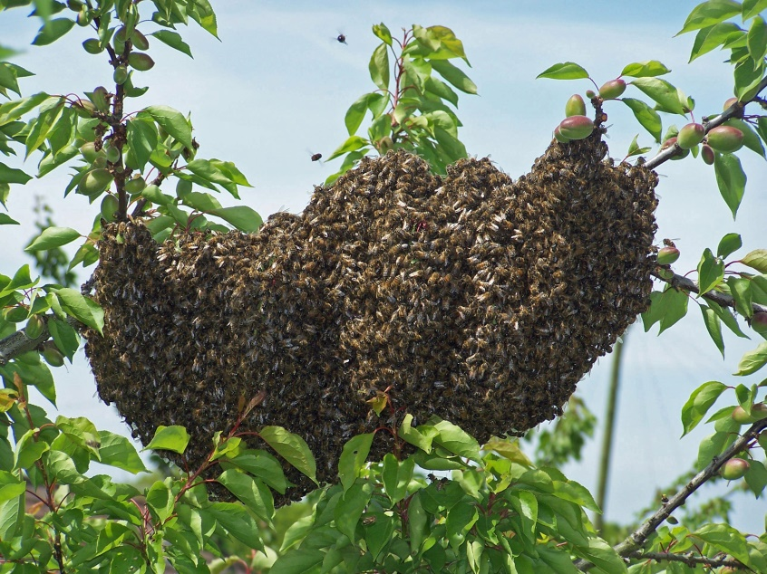
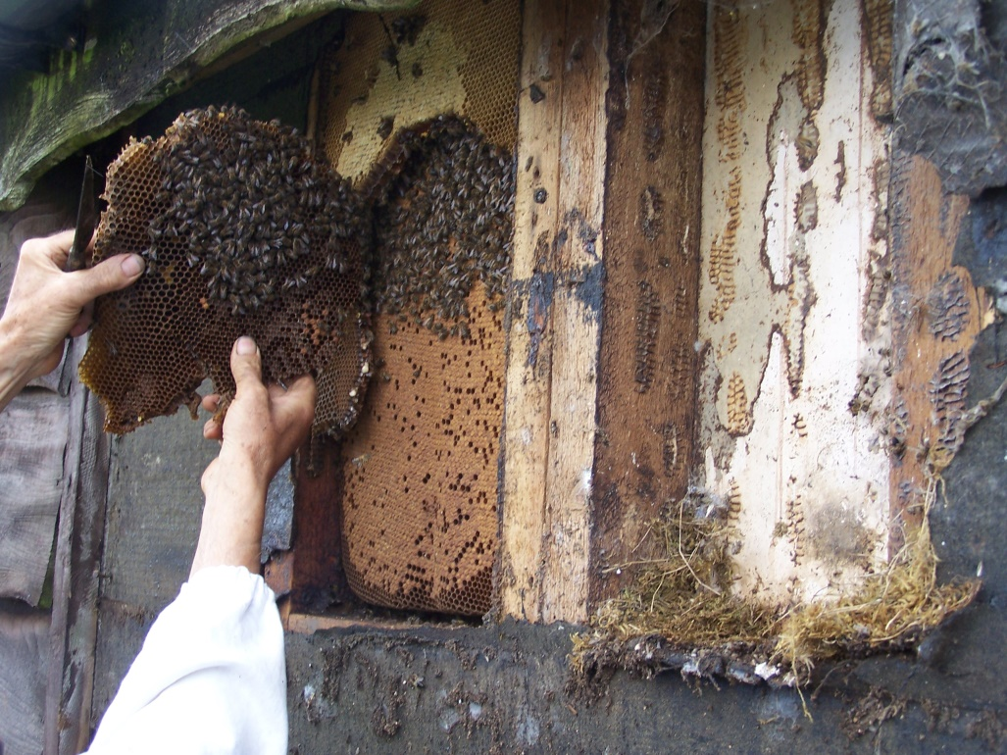
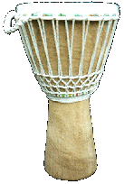
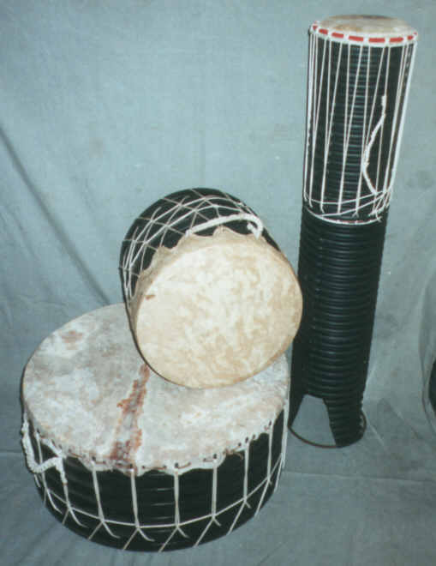
Bees and drums!

Slide 14
Natural Energy Education Project 1988
I worked with a small group to produce a pack promoting renewable energy and campaigning against nuclear power. My role was producing the leaflet about renewables – using Letraset and pasting pictures and text together to layup the leaflet (before the days of computers and Microsoft Publisher !!)
I had to speak to some large groups about Renewables – terrifying!

Slide 15
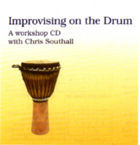
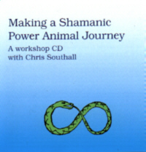
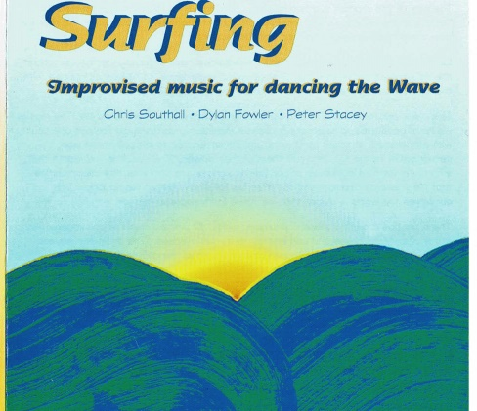
Drumming and Dancing the 5 Rhythms
In my 50s I started to learn about self development;
After 2 years of my own therapy I committed to learning about Shamanic Dance
I went to the USA to train as a 5 Rhythms dance/movement teacher and then integrated 5 rhythms dance with my work with the African drum
I spent 2 more years of learning group-work by trading my drumming for workshops . I struck out on my own and made my living running groups and residential workshops
In Shamanic (therapeutic) dance and drumming, sweat lodge, wilderness living and drum making for the next 9 years.

Slide 16
Green local & national politics
Green party started in 1970 & was called ‘People’, then ‘Ecology Party’ in1975 and became The Green party in 1985 when Jonathan Porritt was the leader , It had great success in the 1989 euro election with about 15% of the vote but no MEPs as it was not a proportional representation vote. I stood in the local elections in 1988 and did well (20% and 24%) but was not elected

Slide 17
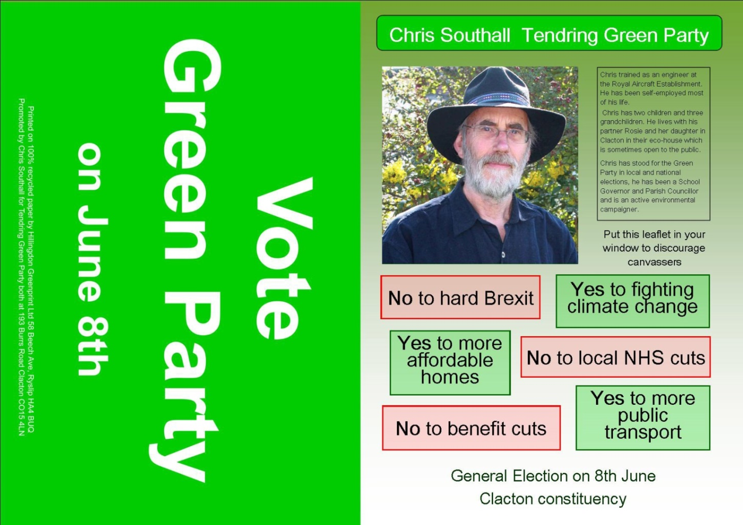
Green local & national politics
Standing in the general election 5 times (including the Ukip by-election against Douglas Carswell achieving the vote up to about 3% much the same as the national average vote for the Green Party

Slide 18

The UKIP by-election BBC news

Slide 19
Tendring Politics
In the last Tendring District election the Tendring Green Party contested 19 seats with a range of results up to 10% of the vote but no one elected.
The council now has a mix of Tory, Labour and independent councillors with no one party having a majority

Slide 20
The Green Party Nationally
There are over 530 District and County Green Councillors representing communities across England and Wales.
7 councils where Greens have a controlling position
There are also over 400 town and parish councillors who are members of, or represent the Green Party across England and Wales.

